Slide 1
IIZ WINTER SCHOOL CONFERENCE 2015
“ENTREPRENEURIAL SPACE IN THE INSURANCE SECTOR- A CORPORATE AND RISK MANAGEMENT PERSPECTIVE”
PRESENTED BY: SHINGIRAI SIKOMWE(0773744844)
25 August 2015; Montclair Hotel & Resort, Nyanga

Slide 3
FAILURES
One day all the employees reached the office and saw a big notice written on the door. “Yesterday the person who has been stopping your growth in this company passed away. You are invited to join the funeral. In the beginning, they got sad for the death of one of their colleagues, but after a while they got curious to know who was the man who stopped their growth. Everyone thought: Well at least the man who stopped my progress died! One by one the thrilled employees got closer to the coffin, and when they looked inside they were speechless. They stood shocked in silence, as if someone had touched the deepest part of their soul. There was a MIRROR inside the coffin and everyone who looked inside could see themselves..There was a sign next to the mirror that read:
Failures have common characteristics : They complain, they justify their failures and they blame..blame others and everything

Slide 4
FAILURES
: There is only one person who is capable to set limits to your growth...It is YOU. You are the only person who can influence your happiness, success and realisation..Your life does not change when your family, boss, friends or company change.....your life changes when you change...you go beyond your limiting beliefs and you realize you are the only one responsible for your life. Its the way you face life that makes the difference! If an egg is broken from outside force....life ends but if it is broken from inside force life begins. Great things always begin from our inside..You be the change, don't wish things were easy, Wish you were Stronger.
“Many of life failures are people who did not realise how close they were to success when they gave up” Thomas Edison

Slide 5
THE EMBATTLED CORPORATION
Customers
Fragmented markets require companies
to adopt multiple approaches to serve
different target audiences
Rapidly rising customer expectations
force companies to customize their
products, customer support function,
and communication approaches, and yet
do so in ways that can be standardized
The costs of higher levels of customization
require companies to cultivate longer-term
customer relationships
Sustainable growth means learning new
skills in serving global markets

Slide 6
Competitors
Competitors lead customers to entirely new
market spaces, forcing companies to spend
greater amounts on product development
Aggressive competitors move quickly to
mimic anything new attempted by the
company, making it harder to differentiate
the company in the eyes of customers
Companies find themselves competing with
companies in other industries that play by
completely different rules-making current
competitive approaches irrelevant
Competitors specializing in narrow,
profitable niches avoid costs of competing
across a broader product and customer range,
while attacking the company's most profitable
areas of business

Slide 7
Technology
Companies have to change the ways they
operate internally and how they compete
externally based on:
New information management
technologies
New production and service
delivery technologies
New customer management
technologies
New logistics and inventory
management technologies
New sales force management
technologies
New product development
technologies

Slide 8
Legal, Regulatory, and Ethical
Standards
Companies are increasingly accountable to
multiple stakeholders, and their actions are
more visible to these stakeholders, forcing
management to make difficult choices and
deliver results while behaving responsibly
An increasingly litigious environment raises
the stakes on company liability for products
and how they are used; more lawsuits increase
company costs and penalize innovative actions
Regulatory restrictions limit choices while
forcing companies to learn new ways to compete
Growing affluence enables society to hold
companies more responsible for the
environmental and social implications of
their actions
Notes:
Triple bottom line( integrated reporting),green marketing etc.

Slide 9
Developments in eight major domains of a company’s external environment:
Technological Environment
Accelerated development of
new technologies; rapid
Product obsolescence, greater
difficulty in protecting
intellectual property.
Economic Environment
Unpredictability of prices, costs, exchange rates, interest rates, tax incentives, business cycles and product cycles

Slide 10
ENVIRON CONT’
Competitive Environment
Aggressive “take no prisoners” competition; highly
Innovative competitors; competition from non-traditional sources with non-traditional tactics; threats from niche players; competitors who are also customers or partners.
Labour environment
Growing scarcity of skilled workers; employees more
mobile and less loyal; higher employee benefit costs;
reliance on Contract labour.

Slide 11
ENVIRON CONT
Customer Environment
More demanding and complex customers; markets that are
more fragmented and more narrowly segmented; emphasis on investing in and capturing a customer’s life time value.
Resource Environment
Increasing resource scarcity; resources increasingly
specialized;
unknown sources of supply; more rapid resource obsolescence

Slide 12
ENVIRON CONT
Legal and Regulatory
More aggressive regulation; virtually unlimited product
liability; Environmental regulatory compliance costs, growing emphasis on free and fair trade; increasing environmental regulation and associated compliance costs; mandated employee benefits
Global Environment
Real-time communication, production, and distribution
Virtually anywhere in the world; more sophisticated suppliers, customers, and competitors located around the world; competitive advantage achieved through global outsourcing and international strategic alliances

Slide 13
The 5 Domains
Adaptability –
the ability to adjust, on timely basis, to new technologies, new customer needs, new regulatory rules, and other changes in conditions without losing focus or causing significant disruption of core operations and commitments
The quest for competitive advantage requires that the company and managers within continually reinvent themselves. Specifically, advantage derives from five key company capabilities. These include:

Slide 14
The 5 dormains cont’
Flexibility –
the ability to design company strategies, processes, operational approaches that can simultaneously meet the diverse and evolving requirements of customers, distributors, suppliers, financiers, regulators, and other key stakeholders.
Speed –
the ability to act quickly on emerging opportunities to develop new products and services more rapidly, and to make critical operational decisions without lengthy deliberations.

Slide 15
The 5 dormains cont
Aggressiveness –
an intense, focused and proactive approach to eliminating competitors, delighting customers, and growing employees;
Innovativeness – a continuous priority placed on developing and launching new products, services, processes, markets, and technologies, and on leading the marketplace

Slide 16
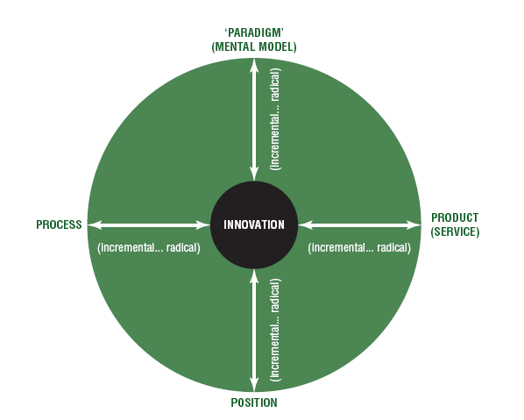

Slide 17
Categories of Organizational Constraints on Corporate Entrepreneurship
 |  | Strategic | Policies and
Systems | Structures | Direction | Procedures | People | Culture
• Misdirected | • Too many | • Absence of | • Long, complex | • Fear of failure | • ill-defined
reward and | hierarchical | innovation goals | approval cycles | • Resistance to | values
evaluation | levels | • No formal | • Extensive | change | • Lack of
systems | • Overly narrow | strategy for | red-tape and | • Parochial bias | consensus
• Oppressive | span of control | entrepreneurship | documentation | • "Turf" protection (NIH SYNDROME) | over value
control | • Responsibility | • No vision from | requirements |  | and norm
systems | without | the top | • Over-reliance on | • Complacency | priorities
• Inflexible | authority | • Lack of | established rules | • Short-term | • Lack of fit of
budgeting | • Top-down | commitment | of thumb | orientation | values with
systems | management | from senior | • Unrealistic | • Inappropriate | current
• Arbitrary cost | • Restricted | executives | performance | skills and | competitive
allocation | communication | • No entrepre- | criteria | talents for | context
systems | channels | neurial role |  | managing | • Values that
• Overly rigid, | • Lack of | models at |  | entrepreneurial | conflict with
formal planning | accountabi lity | the top |  | change | innovative-
systems | for innovation |  |  |  | ness, risk-
 | and change |  |  |  | taking, and
 |  |  |  |  | proactive ness

Slide 18
RISK MANAGEMENT PERSPECTIVE
In terms of risk management, the King Committee (2002, 98) states that
the board is responsible for:
Ensuring that processes and outcomes of key risk indicators are undertaken
on an annual basis
Appointing a board committee or an appointed dedicated committee that
should review the risk management process and the significant risks facing
the company
Disclosing risk management in the annual report
Ensuring that the internal audit function provides an independent assurance
that the internal controls ensure effective risk management
Ensuring that there is compliance with the applicable regulations

Slide 19
BYE
LETS MAKE MONEY NOW!!!!!!!

