Slide 1
Surviving the Financial Meltdown –Doom, Gloom or Potential Boom Terrence Chimanya – MSc, LLB (Hons), ACIS, AIRMSA Executive Director – Diaspora Infrastructure Development Group (DIDG) (www.didg.co.za)
Notes:
To use this title animation slide with a new image simply 1) move the top semi-transparent shape to the side, 2) delete placeholder image, 3) click on the picture icon to add a new picture, 4) Move semi-transparent shape back to original position, 5) Update text on slide.

Slide 2
INTRODUCTION
Our mission
As Immigrants in foreign countries, are Zimbabwean capable of getting the ‘job’ done? True or False?
What is the responsibility of Zimbabweans in this Native land of Zimbabwe?
As a collective in the Insurance Industry, are WE contributing to the creation of a gloom, doom or potential boom the economy?
Is our end narrative to future generations, that of doom, gloom or potential serious boom?
Through my experience, I’m persuaded to believe that because of their ability to prepare for the worst, Immigrants are more likely to get the job done that their native- born counterparts!!!!!

Slide 3
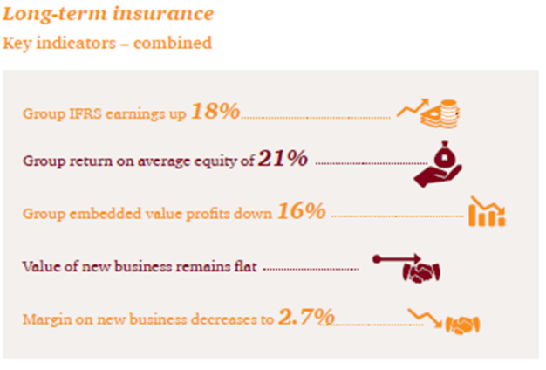
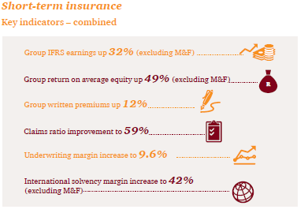
2016 PwC INSURANCE INDUSTRY ANALYSIS
Overall Context
2015 marked the end of business as usual’ for South African and Sub Saharan long- and short term insurers.
China’s slowing growth, declining global commodity prices and strengthening of the US dollar against emerging market currencies are threatening the growth prospects of economies in Southern Africa.
Sub-Saharan Africa’s growth has also started to weaken after over a decade of solid numbers. Declining global commodity prices have already had significant negative impacts on economies such as Nigeria, Angola and Namibia.
International Monetary Fund is still predicting a combined growth rate of around 4.5% for sub-Saharan Africa in 2016 going forward.
It has thus become clear that insurers have to quickly break away from ‘business as usual’ and find new ways to achieve growth.
Medium - to long-term trends that will disrupt the insurance industry by 2020, more so than most other industries. Chief among these longer-term trends are developments such as: FinTech, changing demographics, regulation, the rising significance of emerging-market economies in the longer term, and changing climate and sustainability issues.

Slide 4
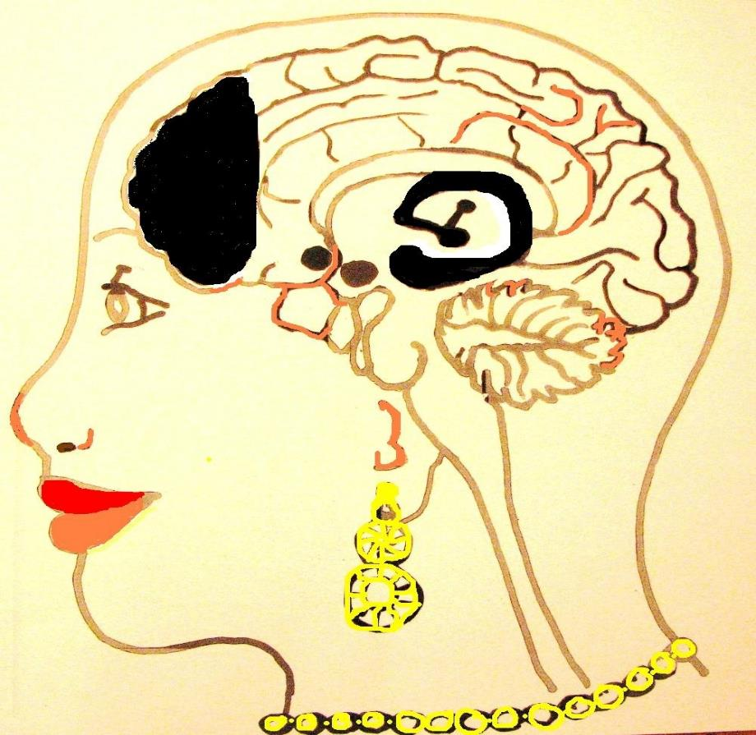
“IF YOU WANT SOMEONE TO REMEMBER YOUR MESSAGE OR LISTEN TO YOU –
TELL THEM A STORY.”

Slide 5
WHAT’S YOUR WHY?
Why
How
What

Slide 6
CHALLENGING THE STATUS QUO..
Becoming Innovative
Innovation is everywhere in our rapidly-changing world.
If creativity is the ability to generate new ideas, innovation can be thought of as the processes of bringing those new ideas to realization.
Market Research
Market research is key in maintaining competitiveness and awareness of customer needs
It’s key to providing vital information, identify and analyze the market need and overall segmentation
Risk Management
All insurance companies need be creative around identifying risk beyond the traditional approaches.
Correct Risk Management practice will stimulate innovation thus creating boom and opportunities for business.
Collaboration
Importance of building alliances is key
customers, employees and organizations are much more connected thus changing the face of business practice
Time Horizon
5 yr thinking strategy capturing the importance Customer Experience Philosophy aligned to your proposition (EVP)

Slide 7
HOW DO WE MOVE FORWARD?
Self-awareness
Introspection
Insight
Judgement
Evaluation
Inhibition

Slide 8
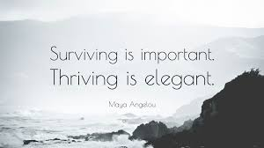

Slide 9
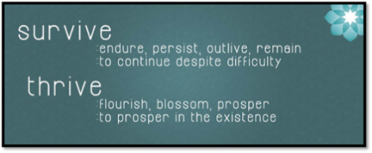
HOW DO YOU DEFINE SUCCESS?
WHAT ARE YOUR NON-NEGOTIABLES?
WHAT WILL YOU GO TO BATTLE FOR?

Slide 10
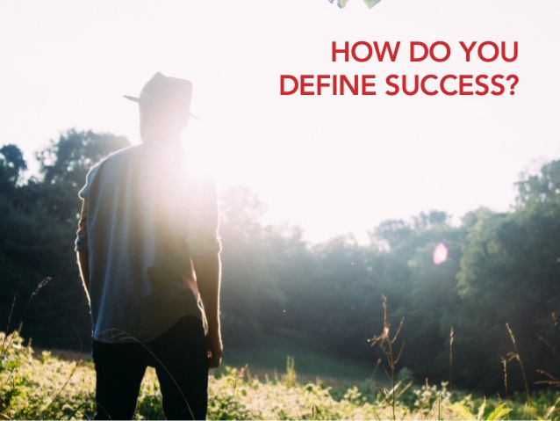

Slide 11
SUSTAINABILITY
FROM SURVIVING TO THRIVING
Crisis Stabilization.
Addressing a deteriorating situation and taking control of cash flow and short-term financing.
Leadership.
Having the right talent with the right competence, skills and capability.
Stakeholder Support.
Key Communication with all relevant internally and externally Stakeholders
Strategic Focus
Asset reduction and focus on the core business. Rejuvenating your business, making the tough decisions on harnessing resources
Organizational Change
Establishing new terms and conditions for employment and making structural changes to run with a smaller team. Once the strategic direction of the business is set, the team needs to be shaped to implement the plan.
Critical Process Improvement.
Cost reductions, quality improvements, and increasing revenues.
Financial Restructuring.. Assessing liabilities and making financial commitments to a level that the renewed organization can meet
Source: Kenneth H. Marks

Slide 12
People stop aspiring when the pain of disillusionment becomes too great
- Christo Nel (1992)

Slide 13
CONSEQUENCES
THE FINANCIAL MELTDOWN – HOW DO WE SURVIVE ITS ONSLAUGHT
SOCIO-POLITICAL
The socio-political challenges are “huge“ and are not going to disappear overnight so we need to understand them and become innovative and creative to the point of working around them to create solutions for our clients.
One needs to be realistic in the products that they put out to the market.
We have to be honest, accountable and move with the times but prepare for a change eventually
SOCIO – ECONOMIC
Appreciating the socioeconomics (also known as social economics) the social science that studies how economic activity affects and is shaped by social processes prevalent in a society.
One therefore needs to understand the processes at play in Zimbabwe and appreciate that the way you do business has to change.
In general it analyzes how societies progress, stagnate, or regress because of their local or regional economy, or the global economy.
FINANCIAL
One has to fully understand and appreciate the financial onslaught and how it impacts customers before adopting their operating model to the situation at hand.
Rebranding becomes a necessity

Slide 14
Nuclear warfare is not necessary to cause a breakdown of our society. You take a city like Harare, Mutare, Gweru — their water supply comes from around the Cities and any interruption of that, or food, or power for any period of time you're going to have riots in the streets.
Our society is so fragile, so dependent on the interworking of things to provide us with the goods and services that you don't need nuclear warfare to fragment us anymore than the Romans needed it to cause their eventual downfall.
Inspired by — Gene Roddenberry

Slide 15
BUILDING RESILIENT BUSINESS and AVOIDING FINANCIAL MELTDOWN
SUSTAINABILITY

Slide 16
Insurers as visionaries.. painting a picture of the future, being aware of current and future risks, managing risks as you move towards the desired “future”
**Key here is creating a future in which business thrives, the customer is happy and the returns are huge…….

Slide 17
(c) Penny Milner-Smyth

Slide 18
BUILDING RESILIENT BUSINESS
CREATING GENERATIONAL SUSTAINABILITY IN THE INSURANCE SECTOR IN ZIMBABWE
THE BAMBOO ANALOGY

Slide 19
Lessons from Bamboo
In Japan, Bamboo is a symbol of good luck and used widely within their new year’s celebrations.
Over the winter, heavy snow bends bamboo back and back until one day the snow becomes too heavy, begins to fall, and the bamboo snaps back up tall again, brushing aside the snow. The bamboo endured the heavy burden of the snow, but in the end it had to power to spring back.
The image here of young, fresh bamboo represents the ability to spring back after experiencing adversity.
http://www.theresilienceprogramme.co.uk/resilience-programme/bamboo

Slide 20
Be flexible yet firmly rooted
In the forest, a bamboo tree will sway with even the slightest breeze. This mild swaying movement with the wind can be seen as a symbol for resilience. Although their branches are firm, and their trunks firmly rooted in the ground below, they can sway gently in the breeze, responding to the changes in the seasons and the weather without losing their ground. In time even the strongest wind tires itself out: the bamboo remains standing tall and still by not rigidly trying to fight it.
In some cultures, bamboo is used as infrastructure. That’s because it has the flexibility to bend and move with the trauma, rather than being rigid, unyielding and ultimately vulnerable to an unexpected jolt and sideways shift.
That ability to yield gracefully, move non-linearly, give way rather than resist can be essential to you flourishing.
A ‘bend but don’t break’ approach is a secret for success whether we’re talking about bamboo trees, managing your team through change, or just dealing with the everyday challenges of life.

Slide 21
Commit to continuous growth
The bamboo tree is one of the fastest growing plants on our planet. When we commit to continuous learning and development, our own growth can mirror this pace. It can be a surprise to look back at what or where we used to be, and see how far along a journey we actually are.
When we are making progress, we may not notice our improvement: but how fast is not the main concern, only that we’re moving forward. Do not be discouraged by what you perceive as your lack of growth or improvement, but if you have not given up, then you are growing. You just may not see it until much later.

Slide 22
What looks weak is strong
When compared with larger trees in the forest, a single bamboo tree may look frail or even weak. However, it endures both cold winters and hot summers, and can often be the only tree left standing after devastating typhoons. Although they don’t grow to be as tall as other trees, they are strong and remain rooted in these extreme weather conditions.
We would be mistaken in thinking that bamboo is weak – as it is not as fragile as it might appear. As we deepen our knowledge of what constitutes strength, we can learn not to underestimate others or ourselves based on old notions of what is weak and what is strong.
Taking time out to explore any difficulties you might be experiencing can have a profound effect upon many aspects of your life, including your work, your relationships and ultimately how you view yourself. It is a sign of courage, not weakness.

Slide 23
Be ever ready
Unlike other types of wood which take a good deal of processing and finishing, bamboo needs little work. This applies to people too: often we instinctively know the right course of action, the best approach… the answer might just need a little finishing.
Through training and practice, we can learn to tap into this inner wisdom, so that solutions to problems require less processing and less energy

Slide 24
Find wisdom in emptiness
If we are to truly learn a new idea, technique or concept, the first step is to empty ourselves of our preconceived notions. The hollow insides of the bamboo remind us that we can often be so full of our own conclusions that we have no space for anything else.
We cannot fill ourselves with new information if we are already full. In order to receive wisdom from both nature and people, we have to be open to that which is new and different.
When you empty your mind of your prejudices, you become open to the possibilities.

Slide 25
Express usefulness through simplicity
We can spend a lot of our time trying to prove how smart we are, perhaps to convince others and ourselves that our position in the world is justified. Because of this we may complicate the simple to impress, concerned that others may know what we know and realise it was simple all along.
Our personal and professional lives can be complicated enough, without making things even more complicated! Perhaps if we could let go of this desire to impress, we could be more creative and find simpler solutions to even complex problems. It is these solutions that ultimately provide the greatest usefulness for our customers, colleagues, or loved ones.

Slide 26
Bide your time
Bamboo takes two to three years to establish its root system, during which time very little bamboo growth happens ‘up top’. But once the root system is in place, the growth is extraordinary – it can shoot up more than 20 meters in less than four months.
The metaphor is obvious but no less powerful for being so. We can be driving so hard to get things done that we can miss the importance of investing fully in our root system. The cost of that is being fragile, less solid, not as well grounded. The challenge is that our root system is often the less sexy part of what we do. It is systems, relationships, processes. It’s also clarity about who we are, what we’re good at, what we’re focusing upon, what matters

Slide 27
Be prolific
Do you target one thing or do you try out many? This question matters, whether you’re juggling things in your role at work or are an entrepreneur in your own right.
It’s a tough call. On the one hand, there’s benefit in stepping fully into one project and avoiding SOS (“shiny object syndrome”), but the cost is you may be overly committed to something that won’t work. On the other hand, there’s value in keeping your options open and seeing what develops, but the cost may be that you never make real progress on anything as you dabble in many projects.
I think there’s something interesting in what bamboo does. Lots of shoots spring up everywhere, but soon enough it becomes clear which will grow and which will get crowded out.

Slide 28
Going Forward
Be the catalyst to the change that creates boom and potential opportunities for you and your business. The message is simple………
1
Consider Potential Challenges
2
Make a plan – advocate for a paradigm shift in thinking and how we do business
3
Execute the Plan bearing in mind the needs of the customer and stakeholder looking ahead

Slide 29
THE BOOM STAGE HAS BEEN SET what is now left is for you to follow the basic 5 steps and be creative, create alliances and know your customer as that will create the returns you desire in this tight market.
1
2
3
4
5
Understand your brand and stakeholders; let your products speak in an authentic voice
Get your facts straight with 5 W’s and make sure that the customer or stakeholder fully understands who you are.
The power of specifics, details, and imagery that attracts potential customers
Show, don’t tell, be responsive show that you care
Know the end at the beginning
Reference : The basics you can find anywhere 5 Steps To Successful Storytelling Published on April 5, 2014 Featured in: Marketing & Advertising

Slide 30
BECAUSE STORYTELLING, AND VISUAL STORYTELLING, WAS PUT IN MY HANDS FOR THE LAST 45MINS,
YOU HAVE ALL BECOME GOOD LISTENERS BUT THE TIME TO BECOME GOOD STORYTELLERS IS NOW YOURS SO THAT WE ERADICATE GLOOM AND DOOM AND CREATE BOOMING OPPORTUNITIES IN BUSINESS FOR ALL OF US.
—LEVAR BURTON

Slide 31
Questions
THANK YOU

