Slide 1
INSURANCE INSTITUTE OF ZIMBABWE WINTER SCHOOL – TROUTBECK NYANGA 21 – 23 AUGUST 2017 Topic: “The Future of Healthspan and Lifespan – Emerging Developments in Living Benefits”
By
Washington Madziwadondo
MD Medical Aid Division - Cimas

Slide 2
OVERVIEW
Definitions
The Future as I see it – Developed and Developing World
The Past
Key Indicators of Healthspan and Lifespan
The Dilemma
Emerging developments
Projections – The Ideal Future
Recommendations
Discussion

Slide 3
“Study the past if you would define the future.” ― Confucius

Slide 4
Definitions
Healthspan – “period of one’s life during which one is generally healthy and free from serious disease. …the number of years you live in the best health possible” Dictionary.com (2012-14)
…”period of time during which a human being, animal, machine etc. may be expected to live or function under normal conditions”. Collins English (Digital) Dictionary (2017)
Lifespan – “the longest period over which the life of any organism, species, may extend in accordance to the available biological knowledge concerning it…..longevity of an individual” Random Hse Dictionary (2017)

Slide 5
The Future as I see it – Developed and Developing World (Africa)
Developed World – walking in old age – Healthspan? Lifespan?
Africa – working in old age Healthspan? Lifespan?

Slide 6
The Past
Developed world – exploitation and slavery leading to productivity, agricultural revolution, mechanisation, industrialisation, modernisation, fight for equal rights (the enslaved and the slave masters)…..
USA – lifespan at birth between 1900 to 2010 almost doubled from 47.3 to 78.7 – CDC/Centre for Health Statistics 2012, 2013
Declines in deaths due to infectious diseases (mainly affecting the young), in the 20th century cardiovascular disease and cancer dominated the causes of death. The control of these led to increase in life expectancy to 100 years. Eileen M Crimins – Oxford University Press (2015)
Developing world – Victims of Circumstances – we have been marginalised, enslaved, exploited, oppressed, …..the list goes on…
Zimbabwe is suffering from lifestyle disease in 2017, cancer and heart disease are ravaging…

Slide 7
The Past cont….
Zimbabwe …” Men This category was often divided into bachelors, monogamists and polygamists, but it is very rarely shown how wives were distributed within the latter category. After 1903 marriages were supposed to be registered and in 1904 NC Matobo recorded that out of 228 marriages in his District in that year, 118 were with a first wife, 69 with a second, 29 with a third, 6 with a fourth, 4 with a fifth, 1 with a sixth, and 1 with a seventh.
Married women As noted above, this category could include girls under 14 or 15 years of age and many widows. Between 1904 and 1921 girls seem to have begun to marry later.”
Source: Michigan State University Libraries ---ZIMBABWEAN DEMOGRAPHY: EARLY COLONIAL DATA.. D N Beach --- Dept. of History: University of Zimbabwe (Zambesia:1990)

Slide 8
Key Indicators: Healthspan & Lifespan
No. | Indicator | Developing | Developed
1 | Lengthy of Period when healthy (Cimas 2016), CDC 2017 | 4 months (on average 3 visits per year) - Zim | 6 months (on average 2 visits per year()
2 | Life Expectancy (World Bank 2015 | Males – 59 years, females 62 years (Average 60.5 years WHO, WB: 59,161 years) | Japan 83.84 years, UK 81,6 (82.8 women); USA 78,74
3 | Fertility Rate: births per woman (WB 2015); ZDHS 2015 – Zim only | Zim 3.8, Zambia 5.28, Moz 5.3, Nigeria 5.59, Senegal 5.03 | UK 1.81, USA 1.84, Japan 1,46, Germany 1.55, India 2.4
4 | Mortality Rate – Maternal (WHO 2015) | Zim – 1980 – 90/100K 1990- 440/100K vs 2015 – 614/100K
5 | Infant Mortality Rate (ZDHS 2015) | 50 deaths/1000 - Zim | UK – 3.7/1000

Slide 9
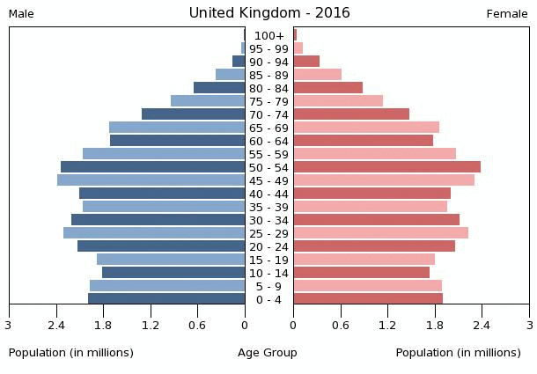
Key Indicators: Healthspan & Lifespan Cont...WB

Slide 10
Key Indicators: Healthspan & Lifespan Cont...
What Zimbabwe Needs
Zimbabwe Fertility Rate
A good Healthspan leads to a good lifespan
UN considers maternal mortality rate of 100 to be low and that of 300 to 499 to be high
The MoH (2015) said we need a reduced FR to match economic growth – I think we need the reverse
The Insurance Sector must drive the Agenda (learn from Zambia, Nigeria, Moz, Senegal

Slide 11
The Dilemma
What leads to sustainable Insurance Business
Crude Death Rates – Insurance Link
Do insurers make money from service access or from Healthy Healthspan and Lifespan
From both, but much money is made from the good Healthspan and Lifespan
Taking active role in Sustainable Development GOALs – Cimas, Coca Cola (Linking Agric to Pet Production) and Unilever are ahead.
2012 Zim Crude Death Rate was 10/1000. Zimstat Mortality Report, August 2015
Qn: what is the impact to insurance coys, what does it mean for the Lifespan and Healthspan
UK during the same period was in the region of 8,7.

Slide 12
The Dilemma Cont…..
Top 10 Major Killers in USA
Diseases (MedicalNewsToday.com (MTN 2014-2017)
Heart Disease
Cancer (malignant & Neoplasms)
Chronic lower respiratory disease
Accidents – unintended injuries
Stroke – Cerebrovascular diseases
Alheizmer’s disease (Dementia)
Diabetes
Influenza – Pneumonia
Kidney disease
Suicide

Slide 13
The Dilemma Cont…..
Top 11 Major Killers in Zimbabwe
Diseases (World Lifeexpectancy.com)
HIV
Influenza – Pneumonia
Cancer (malignant & Neoplasms)
Stroke
TB
Diarrhoeal Disease
Heart Diseases
Maternal Diseases
Lung diseases
Diabetes Mellitus
Suicide

Slide 14
Emerging Developments
Boundaries are useless!!
Do you really need to be physically away from Zimbabwe to be in UK, USA etc?
Globalisation – collapsed silos per continent
Emergency of diseases of the rich (NCDs)
Technology making the global village a reality
Global insurance players tapping into the Africa – Emerging Markets
Organisations investing in Sustainable Development…. A Must for Zimbabwean Insurer
….Why are we lagging behind on Healthspan and Lifespan if our challenges are nearly the same?....

Slide 15
The Future as I saw it – Developed and Developing World …..am I still correct?
Developed World – will it Sustain this??
Africa – Is this going to change??

Slide 16
The Ideal Future …. US Census Bureau is seeing with a different lense

Slide 17
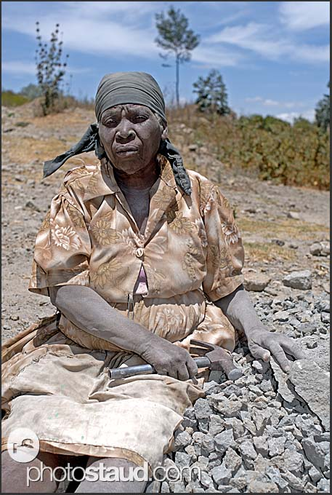
The Ideal Future …. The Insurer’s Role…in Zimbabwe
Invest in Sustainable Insurance Development
Actively participate in the legislative development
Participate in infrastructure development
Have an Agenda for Healthspan and Lifespan
Leapfrog from Poor Healthspan and Lifespan – to the catch up with Developed World
Take a leading role in developing the emerging market

Slide 18
Ideal Future …… Can we ignore this? 17 MDGs
No Poverty – 920 million people sleeping on empty stomachs
Hunger – extreme poverty = living on less than $1.25 per day
Good Health – 11 children die every minute
Quality Healthy Education – 170 million pple could be lifted out of poverty if all students learned basic reading skills
Gender Equality – women work 70% of the world working hrs yet earn 10% of the world’s income
Clean Water and Sanitation – more have a mobile phone that have a toilet
Renewable Energy – 1,1 billion people are living without energy
8. Good Jobs and Economic Growth – 63c hourly wage for garment mfgng workers in Haiti
9. Innovation & Infrastructure – a simple footbridge btwn rural communities can increase business growth by 15%
10. Reduced inequalities – 8 richest pple in the world own 3.6 billion poorest people’s wealth
11. Sustainable Cities & Communities – ½ of humanity lives in Urban Areas (in Zim it’s just over 40% - Zimstat 2012 Census
12. Responsible Consumption – 5 the no. of earths it wld take to support world population if everyone lives like an American
13. Climate Change – 1-4 feet how much sea levels will rise by 2100
14. Life below water – 2,6 billion of world ppn rely on seafood for protein
15. Life on land – 25% more used than the earth can sustain
16. Peace & Justice – world violence costs 14.3 trillion per year
17. Partnerships for attaining SDGs - ½ of the pple living in extreme povertyin 1990 are not anymore
QN: what is the insurance industry doing?

Slide 19
Recommendations
Industry Specific
Individual Insurer
A concerted approach to development of Healthspan and Lifespan in Zimbabwe and other emerging markets
Collaboration between General Insurers, Life Assurers, Health Insurers, Funeral Assurers in development of a sustainable industry
Create the future
Wellness
Constant Underwriting Rules review and strengthening
CPD – IIZ Winter School – strengthen

Slide 20
References
Zimstat – Mortality thematic report August 2015
Zimstat – 2012 National Census Report
Zimstat – Population Projections Thematic Report August 2015

Slide 21
Thank You

