Slide 1
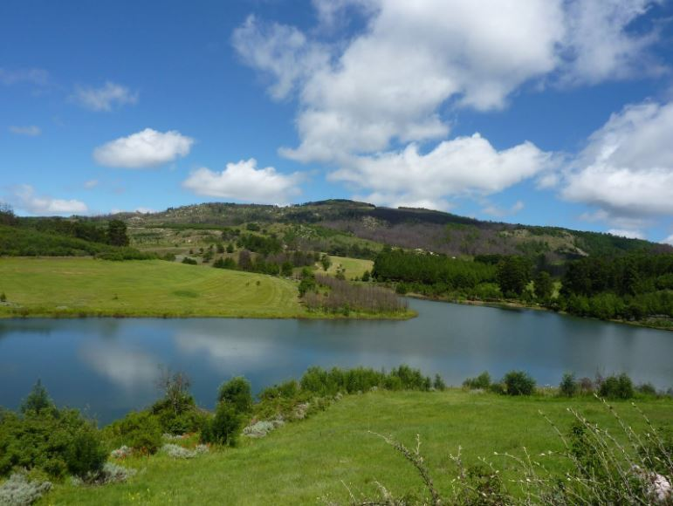
THE OUTLOOK OF THE INSURANCE INDUSTRY- THE GOOD, THE BAD AND THE UGLY
Presenter:
Title:

Slide 2
Overview
Introduction
World Insurance Outlook
Zimbabwe Insurance Outlook
Way Forward

Slide 3
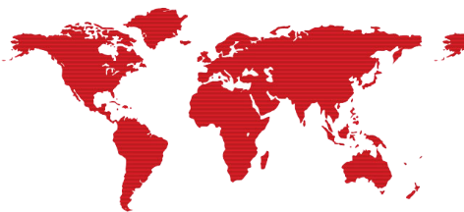
INTRODUCTION
Liveable income for beneficiaries.
Decent burial to beloved ones.
Indemnifies the insured following the loss of insured property/assets.
Closely linked to the performance of the economy.
Global insurance share of GDP has remained constant at 2.7% since 2014.
New business acquisition; low investments; regulation.
3
Notes:
The future may be hard to predict but not hard to prepare.
Increased awareness of the demographic shifts, rapid technology advancements will all help to shape the sector’s long term future
There is a direct relationship between the performance of the economy and insurance business.

Slide 4
WORLD INSURANCE OUTLOOK
Technology

Slide 5
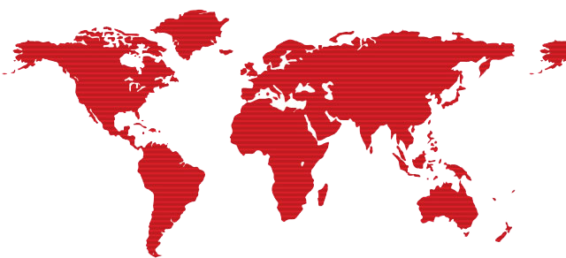
TELEMATICS
(Black Box Insurance)
Personalised performance driving – USA, France, Germany & RSA
Price based on Individual Risk
CLOUD COMPUTING
Internet based Computing
Security Challenges -
Data Protection
User Authentication
Disaster & Data Breach .
04
05
BIG DATA ANALYTICS
Examining large data sets to uncover hidden patterns.
Assists insurers to optimize marketing efforts with predictive analytics & Modelling.
ARTIFICIAL INTELLIGENCE (AI)
impact on insurance (claims assessments; pricing) e.g. driverless cars.
06
03
CYBER RISK
Is any risk of financial loss, disruption or damage to the reputation of an organisation due to failure of Information tech systems.
Cyber crime ransom ware – malicious software used to block computer access.
PwC’s Global Economic Crime survey report 2016: 32% of 232 s.a. companies reported cybercrimes in the last 24 months.
Cyber Insurance: Allianz , Chubb & Travellers .
$2B in premium world wide - US @ 90%.
Could reach $20bn in 10yrs
0
07
MOBILE APPS
monitoring technology
e.g. Discovery Health – Vitality
uses fit bits – stay healthy .
Cheaper Insurance
02
MILLENIUM EFFECT
Tech Savvy generation
Insurance Companies to adopt.
01
08
INSURANCE FRAUD - increased
East Africa 20% gross revenue lost
Tools & techniques to uncover complex or organized fraud activities.
New technology now available e.g. drones for underwriting and claims assessment

Slide 6
WORLD INSURANCE OUTLOOK
Socioeconomic
Environmental
Political

Slide 7
WORLD INSURANCE OUTLOOK
Socioeconomic Changes
Environmental Changes
Political Changes
Regulatory framework
adheres to the monetary & fiscal policy of a country.
Does it attract investors or not?
Customer Behaviors: discerning; financial intelligence - charges on policies; product offer; seek to understand the TCs.
Climate Change
claims and pay-outs increases (storms; massive hailstones hammering cars and homes; lightning damages; mud floods)
Is the public adequately covered?
Capacity of insurers?
High Unemployment rate:
- high Crime rate & Corruption.
Micro insurance – to offer insurance to the formerly marginalized groups.
Shrinking formal sector.

Slide 8
WORLD INSURANCE OUTLOOK
Kenya – working on a micro insurance policy to be released end of this year.
Policy objectives: standardized micro insurance product
features; tax relief and incentives for education and
awareness campaigns etc.
Nigeria – set to grow according to the Nigerian central bank.

Slide 9
INSURANCE PENETRATION RATIOS
Notes:
Insurance penetration is used as an indicator of insurance sector development within a country and is calculated as ratio of total insurance premiums to gross domestic product.

Slide 10
INSURANCE PENETRATION RATIOS
Country | Insurance penetration rate
France (Europe) | France has the highest insurance take up rate – due tax incentives. Above 9%.
Latin America (South America) | Increased by 33%, from 6% in 2002 to 8% in 2010. Growth slowed down since in 2010.
Emerging Asia | the rise was 60%, from 5% in 2002 to 8% in 2010. Growth stopped entirely in emerging Asia.
South Africa | 14.1%, contributing nearly 75% of the total premiums written across Africa
Nigeria | 0.3% Low penetration ratio, 0.6 contribution to its local GDP
Zimbabwe | Declined from 6% to below 1.7% over the past decade.
Notes:
-The insurance penetration ratio varies strongly between regions, due to differences in country-specific regulation and customer demand levels.
-Low levels of insurance penetration indicate room for expansion of the insurance business.
- Increased awareness of the demographic shifts, rapid technology advancements and changing customer behavior will all shape the sector’s long term future.

Slide 11
ZIMBABWEAN INSURANCE OUTLOOK

Slide 12
ZIMBABWEAN INSURANCE OUTLOOK
KEY INDUSTRY STATISTICS
Long term insurance statistics as @ 31 December 2016
4%
Premium income increased by 4%
4%
08
Total assets grew by 9% as a result of increased investments in properties and equities and the registration of FBC re as a composite insurer
9%
Favorable combined ratio - grew by 20% to 87% resulting in healthy operating profit of $48m
$48m

Slide 13
ZIMBABWEAN INSURANCE OUTLOOK
Economic downturn
Insurance prioritization level low
Shrinking disposable income
Company closures
High unemployment
Increased Insurance fraud & speculation
4%
08
Growth of the Informal sector
Launch of the micro-insurance framework by IPEC.
Previously marginalized groups – Vendors , SME’s, Peasant Farmers & low income earners.
Simplified insurance & low cost products (use of other distribution channels).
Technology Update
Internet usage
Internet usage increase; 11.5% in 2011 to 46.5% in 2016.
- Social media.
cybermalls e.g. the Zimselector (platform for buying and selling insurance).
Web Technology (digitalization)
Introduction of icecash to reduce fake cover notes & mobile payment platforms

Slide 14
ZIMBABWEAN INSURANCE OUTLOOK
Political/ country risk
low investor confidence.
Slow growth in the economy (Agric & Mining).
Monetary restrictions – reinsurance companies not able to pay retrocession premiums outside.
- Challenges in paying system license fees.
4%
08
Regulation (IPEC)
Introduced the micro insurance framework.
Insurance awareness campaigns (financial education).
Policyholder protection (mandatory split of assets).
Adherence to prescribed assets.
Corporate governance
To protect policyholders interest - boost public confidence.
Emergence of other distribution channels

Slide 15
EMERGENCE OF OTHER DISTRIBUTION CHANNELS
DISTRIBUTION | BENEFITS
Bancassurance (banks) | Tap into the huge customer base. Simple products required: motor insurance and funeral products Rural penetration – taking advantage of the extensive branch networking. Increases penetration ratio especially from low income earners & formally marginalized people. Convenient premium collections and premium remittances.
Retail Outlets (service stations & supermarkets)
Mobile Networks (telecommunications)
Notes:
Positively impacted on the transacting of business.

Slide 16
ZIMBABWEAN INSURANCE OUTLOOK
Increased Competition
Mobile networks
Banks.
Mergers (regional companies partnering with Zimbabwean companies).
4%
08
Price undercutting – charging unprofitable rates
Small players are scrounging for business

Slide 17
MINIMUM CAPITAL REQUIREMENTS

Slide 18
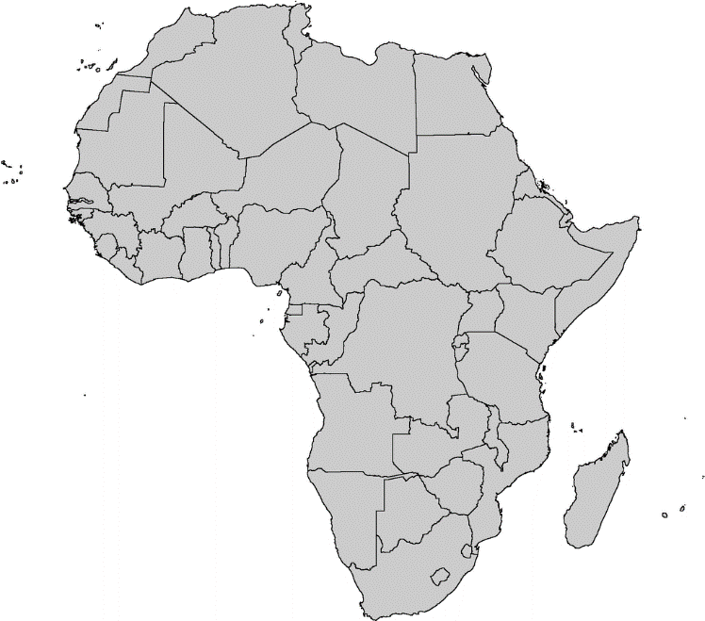
REGUALTOR & MINIMUM CAPITAL REQUIREMENTS
Morocco
Department of insurance and Social welfare ( DAPS)
Approximately $5m for life and non life
Kenya
Insurance Regulatory Authority (IRA)
$ 2m for life insurers, $4m for non life
$ 6m for composite insurers, life and non life reinsurers
Nigeria
National Insurance Commission (NAICOM)
$ 10m for life insurers
$15m for non life insurers
$25m for composite insurers and $50m for reinsurers
Zimbabwe
Insurance & Pension Commission IPEC
$1.5m for non life insurers
$ 3m for life insurers
$ 5m for reinsurers
South Africa
Financial Services Board
( FSB)
$ 850K for life and non life to date
Will increase to $1.25m
Notes:
Source: Lions on the move 2016.
-As at Dec 2015, there were 2,541 insurance players and the number declined by 10.7% to 2,269 in Dec 2016. IPEC, April 2017

Slide 19
THE WAY FORWARD…

Slide 20
THE WAY FORWARD…
Incorporate risk management into the company from top-to-bottom and across the business - essential not an option.
Embrace Technology: “Information Technology and Business are becoming inextricably interwoven. I don’t think anybody can talk meaningfully about one without talking about the other.” Bill Gates.
Strategic partnerships
Innovative products for the informal market: low cost effective products.
“ The antidote to stagnation is Innovation” Robin’s 73 Best Business & Success Lessons.
Simplify Insurance technical jargon: Terms & Conditions should be understood by a layman; vernacular usage.

Slide 21
THE WAY FORWARD…
Keep the promise: Insurance is a promise of compensation for specific potential future losses in exchange for payment.
Claims department is the window of every insurance company. Assess claims thoroughly to avoid arbitration costs & reputational risks.
Treat Customers Fairly: undercutting of prices results in failure to meet claims obligations, leading to negative perception in the market.
“To give real service, you must add something which cannot be bought or measured with money, and that is sincerity and integrity.” Douglas Adams..
Engage Actuaries: on product development & reviews; appropriate pricing; Valuations; product profit testing.
Manage operational costs: business acquisition; internal business processes through leveraging on technology.
21

Slide 22
THE WAY FORWARD…
Insurers and Reinsurers to share risk: adapt to survive in the current and future risk landscape, which is continually shifting.
Difficult to pay premiums to retro-cessioners - spread risk
amongst themselves.
Comply with the Regulator: capital requirements; register all products; license agents; adhere to the Insurance Act.
Industry to lobby the Regulator on enforcement of the ‘S’ rating.
Monitor agents conduct: misappropriation of client funds; misrepresentations.
22
Notes:
make insurance make sense; change negative perception and grow the insurance business to greater heights.
Build a better industry; Unethical conduct only leads to negative perception by the public.

Slide 23
THE WAY FORWARD…
Engage in CRM activities: communicate regularly with your clients; service excellence is key.
Share information: do not operate in silos – exposes the whole industry to fraud.
Shared database on fraud.
The mandate of Life Technical Underwriters Association of Zimbabwe
(LUAZ) is to train life underwriters and claims personnel; share
information; discuss and update on emerging risks etc.
Be active on the Social media: offer free financial education; monitor the comments and respond appropriately.
23
Notes:
-track the customer needs and preferences and continuously review all you do from products; processes and marketing.

Slide 24
STUCK ON ESCALATOR - Video

Slide 25
CONCLUSION

Slide 26
CONCLUSION
Scrutiny of available researches and financial reports of the insurers reveals a high level of optimism.
Let us all go back to the basics, treat customers fairly and be innovative
Charles Darwin: “ it is not the strongest of the species that survive, nor the most intelligent, but the most responsive to change. “
Insurers who can anticipate and plan for change can create their own future.
Fast followers will need to be agile enough to recognise the leaders and adopt similar strategies.
Finally the survivors are likely to be focused on short term performance. WHICH ONE ARE YOU????

Slide 27
THANK YOU
27

