Slide 1
Predictive Analytics – A forward looking perspective on Actuarial Risks
By
Shepherd Fungura, BCom, FASSA, FIA
President of Actuarial Society of Zimbabwe
Group Chief Risk Officer at Old Mutual Zimbabwe
@ Insurance Institute of Zimbabwe Winter School – Monday 22 August 2016

Slide 2
Disclaimer
Views expressed in the presentation are those of the presenter and are not representative their professional membership organisations as well as employer; therefore no liability arising from the presentation should be directed to the said organisations.
The internet was used as a main source of information in this presentation

Slide 3
Agenda
Data and information
Predictive Analytics
Actuarial Philosophy, Risks and Methods
Application of Results
Importance of Business Predictions
From Predictive to Prescriptive

Slide 4
Data and Information
A. Definitions
Data definition
facts and statistics collected together for reference or analysis
Information in raw or unorganized form (such as alphabets, numbers, or symbols) that refer to, or represent, conditions, ideas, or objects
Information definition
facts provided or learned about something or someone
The result of applying data processing to data, giving it context and meaning

Slide 5
Data and Information
B. Sources
Internal
Hardcopy files
Customer database on IT platform
External
Published Financial Statements
Media – print or digital
Government/Regulatory publications

Slide 6
Data and Information
C. Importance in Insurance
Absence of data/information crumbles an insurance company
Complete and accurate data/information may give an insurance company competitive edge when correctly put to appropriate plus good use
D. Uses in Insurance
Pricing
Profit testing
Liability Reserving or Provisioning
Solvency Assessment – or Financial Soundness
Decision Making

Slide 7
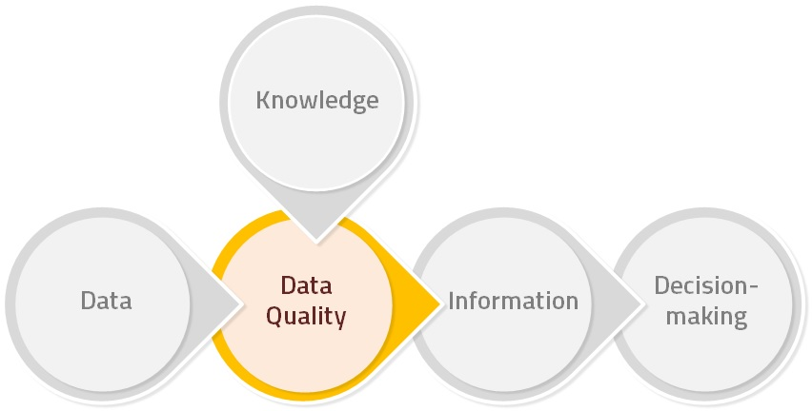
Data and Information

Slide 8
Predictive Analytics
A. Definition
Predictive analytics is the branch of the advanced analytics which is used to make predictions about unknown future events. Predictive analytics uses many techniques from data mining, statistics, modelling, machine learning, and artificial intelligence to analyze current data to make predictions about future.

Slide 9
Predictive Analytics
B. Key Predictive Analytics blocks:
Data mine
Statistics or data analysis e.g. average, minimum, maximum, mode, median, standard deviation
Modelling or data manipulations/calculations
Machine learning & Artificial Intelligence or use of technology i.e. computers
Future predictions or estimations or projections

Slide 10
Predictive Analytics
C. Use of History to Predict Future
Predictive Analytics uses technology to predict the future and influence it. Organizations can use historical performance data to extrapolate and make predictions about the future and take actions that would affect those results.

Slide 11
Predictive Analytics

Slide 12
Actuarial Philosophy, Risks and Methods
A. Actuarial Philosophy
Making sense of the future using history and present experience
Encompasses:
Descriptive analytics – data collection & analysis
Diagnostic analytics – assumptions setting
Predictive analytics – modelling/calculations
Prescriptive analytics – recommendations

Slide 13
Actuarial Philosophy, Risks and Methods
B. Actuarial Risks
Those risks with complexities e.g. uncertainty of when event will take place (insurance – both life & short term) or due to length of time (pensions) or matrix of severity and frequency (short-term insurance) e.t.c.
Mortality risk in life insurance
Longevity risk in pensions or employee benefits
Disability risk in health and care
Reserving/Provisioning risk in short term insurance

Slide 14
Actuarial Philosophy, Risks and Methods
C. Actuarial Methods
Well established – tried and tested
However there’s development and growth in methods used
Common methods are:
Deterministic (statistical, probabilistic and mathematical)
Stochastic (random events modelling)

Slide 15
Application of Results

Slide 16
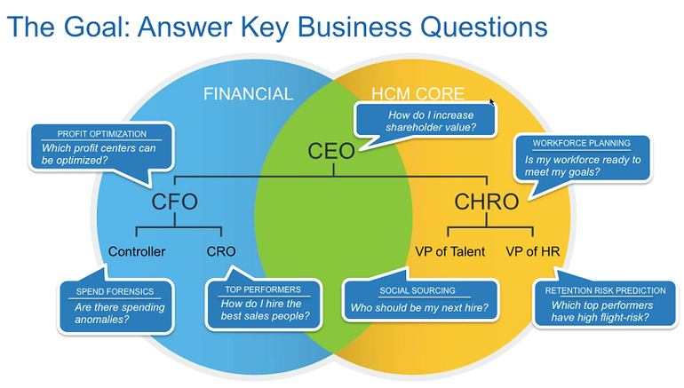
Application of Results

Slide 17
Importance of Business Predictions
Business Planning
Financial Forecasting
Risk Management and Efficiency
Success or Value
Competitive edge
Sustainability or Going Concern
Decision making

Slide 18
Importance of Business Predictions

Slide 19
Importance of Business Predictions

Slide 20
From Predictive to Prescriptive
Predictive analytics shouldn’t be seen as the end goal for your organization, but as a single step in a longer journey. Most companies use descriptive analytics to help them process immediate, incoming data. Predictive analytics can be seen as the next logical step, allowing you to apply that data to make predictions about when something might go wrong and why. Of course, the job isn’t over once you’ve made this forecast — by building the predictive data into concrete solutions for future problems, your predictive analytics become prescriptive

