Slide 1
IIZ 2015 WINTER SCHOOL
THEME: “INSURANCE IN A DIGITAL WORLD – THE TIME IS NOW”
TOPIC: BEYOND THE FUNERAL HOME: FUNERALS IN AN AGE OF TECHNOLOGY
PRESENTER: DR C MAKINA

Slide 2
CONTENTS
QUOTES
FUNNY HUMOUR
INTRODUCTION
VARIOUS TECHNOLOGICAL ADVANCES
CONCLUSION

Slide 3
1. QUOTES
Life is pleasant. Death is peaceful. It’s the transition that’s troublesome – Isaac Asimov - # inspired nuggets
I am not Afraid of death; I just don’t want to be there when it happens – Woody Allen # inspired nuggets

Slide 4
Dying is nothing to be afraid of. For a start you cannot fail at it, and secondly you get a certificate: Dr Joanne Duran # inspired nuggets
Oh death where is thy sting? O grave where is thy victory. The sting of death is sin and the strength of sin is the Law – But thanks be to God, which giveth us the victory through our Lord Jesus Christ. 1 Cor 15 vs 55 - # inspired nuggets

Slide 5
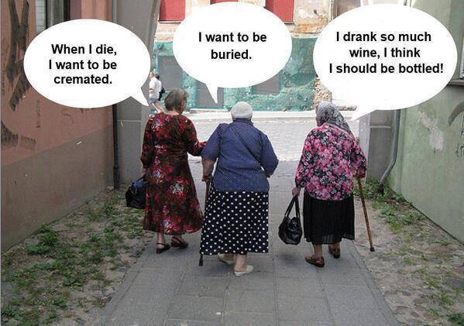
2. F/H

Slide 7
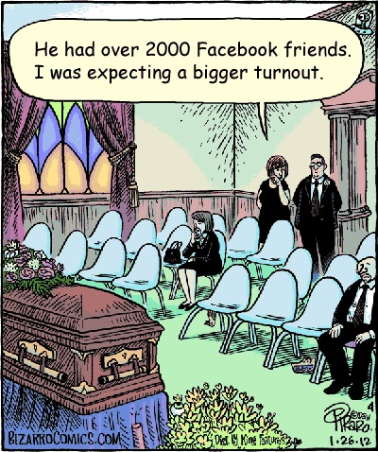

Slide 8
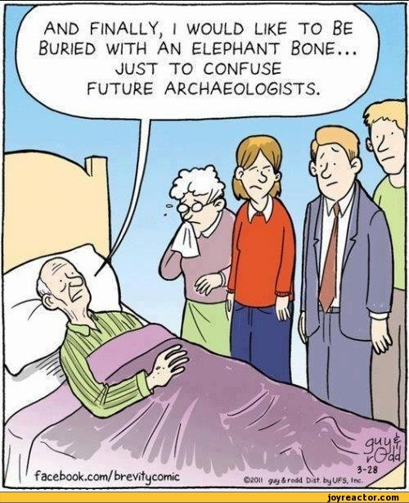

Slide 9
3. INTRODUCTION
When we face the tragedy of death, we look to family and friends to shepherd us through the difficult time. Some give spiritual guidance others help us navigate the strange and delicate logistics. In fact “death care” or what we do with the deceased, dates back to the beginnings of human life. We find it in the bible and we find it being done by the ancient Egyptians.

Slide 10
In modern times, funeral directors do more than simply prepare the body. They co-ordinate and organise burial needs, such as securing a hearse and coffin, and plan the viewing and graveside services. When someone dies grieving family and friends also need a caring professional, and an efficient administrator to handle documents we do not think about in our everyday lives.
Since funeral directors enter our lives at such stressful times, they need a compassion, respect

Slide 11
and knowledge of different customs, rituals and traditions – a delicate balance of a business – like efficiency and an emotional strength and support, all without treading on the boundaries of families during an often tumultuous time.
A funeral is not like a wedding, a wedding is complex – but with the wedding you have more than a year to do it – When there is a death, there is only a week or less to plan for it.

Slide 12
4. VARIOUS TECHNOLOGICAL ADVANCES
Living Headstones use technology to honour the dead. (A Seattle Monument maker affixes a small QR or quick response code like a bar code, but square to the tombstone. A smart phone with the right application lets visitors read the person’s life history online.

Slide 13
High tech headstones speak from beyond the grave. They use QR codes to link to photos and videos of the dearly departed.
Profit Death Cafes – helps people talk about dying – a sign perhaps that the subject is less taboo than it once was

Slide 14
SOCIAL MEDIA
1) We now have websites where families are enabled to collaborate and plan online, while keeping the Funeral Provider up to date with their wishes. These days people are dispersed in the diaspora etc and it can be difficult to communicate but this online planning helps. People can also plan their own funerals. Clients can keep track of all the arrangements. People can also plan for the end of their lives from wills to funerals. People have to make informed decisions, not “distress purchases”

Slide 15
2) Social media is now an integral part of the story when it comes to technology affecting a community after someone’s passing. Online friends are taking on the task of keeping the deceased’s network alive by posting to their facebook wall, sharing personal photos and reminiscing about old times. Someone’s account can stay open indefinately through, the contribution of friends and family members and can serve as a living and changing tribute.

Slide 16
Digital Filing
Its now possible to store important digital files, family photos and wills in remote cloud servers.
Perhaps the most far-fetched, yet not impossible idea doing the rounds is the idea of holography. Hologram technology offers a 3D likeness that can move and speak as if the person were really present. Its expensive for the average person and also the technology has not yet come full circle, it is possible that in the future individuals will

Slide 17
record a personalised hologram message that can be delivered to their families and friends after they pass away.
Telephone
The telephone used to be the first point of contract when a death occurred but now people operate with cellphones and computers. We now live in an age where people send photos and authorizations to the funeral home from their smartphones and use text or whatsapp to communicate with an

Slide 18
Ever-widening circle of contacts. Technology reduces stress for the bereaved family. While we criticise e-mail and texting for being impersonal, in the case of death, that nature allows us to delay or contemplate difficult details, when we are ready – on our own time, in our own private space. Texting is more convenient for grieving members and funeral homes alike, provided the Funeral Director has asked for permission to do so and usually families have permitted Funeral Directors

Slide 19
Funeral directors to use it. People who use technology regularly and are comfortable with it are easier to move into that kind of relationship.
Live Streaming
Online Funerals are on the rise. Families in the Diaspora who cannot travel to the funeral can watch live streaming of a Funeral in progress online on a password protected website.

Slide 20
USE OF AGGREGATORS
This is a website portal or search utility to enable a client to gain several quotes via an electronic e-quote form. The insurance aggregator concludes agreements with a number of Insurers to provide a comparative quote based on pre-determined list of specified needs as disclosed by potential clients. In Zimbabwe Zimselector is a recent addition to the aggregators found all over the developed and developing countries.

Slide 21
Internationally there has been a significant increase in the amount of Insurance contracts concluded via the internet.
OTHER BURIAL ALTERNATIVES
RESOMATION
Dissolving of tissues as an alternative to traditional cremation. The process called resomation or bio-cremation – uses heated water and potassium hydroxide to liquify the body, leaving only bones behind. The bones are then pulverized, much as in regular cremation and fragments returned to family. This process eliminates the carbon footprints that cremation leaves behind.

Slide 22
Cremation releases carbon dioxide as well as trace chemicals such as mercury from dental filling.
ETERNAL REEFS
For those who prefer to nourish a more aquatic environment after death there is the Eternal Reef option. Eternal Reefs create artificial reef material out of a mixture of concrete and human remains. These heavy concrete orbs are then placed in areas where reefs need restoration, attracting fish and other organisms that turn the remains into an

Slide 23
an undersea habitat.
CRYONICS
And then there are those who want to hang on to their old life. Cryonics is the process of freezing a person’s body in the hopes that later medical science will make it possible to revive them, personality and memory intact. There were just over 200 people in Cryonics in the USA as of August 2011. Prices vary depending on the procedure, preservation company and payment

Slide 24
plan, but can range as high as $200 000 for whole body preservation.
SPACE BURIAL
Your ashes can be shot into space by a rocket. According to Celetis Memorial space flights a company that offers the postmortem flights, a low orbit journey that lets your (remains experience zero gravity before return to each starts at $995. A chance to orbit Earth and eventually burn up in the atmosphere runs around $3 000. Dedicated

Slide 25
space lovers can have themselves launched to the moon or into deep space for $10 000 and $12 000USD respectively.
MUMMIFICATION
It is not just for ancient Egyptions price of human mummification starts at $63 000USD. They hope their preserved DNA will enable future scientists to clone them and give them (at least their genes) a second shot at life.

Slide 26
PLASTINATION
- Much like mummification, plastination involves preserving the body in a semi-recognizable form. It was invented by scientist Gunther Von Hagens. Plastination is used in medical schools and anatomy labs to preserve organ specimens for education. But Von Hagens has taken the process further creating exhibits of plastinated bodies posed as if frozen in the midst of their everyday activities.

Slide 27
According to the Institute of plastination, thousands have signed up to donate their bodies for education and display.
FREEZE DRYING
- The newest comer on the eco-burial stage is a process called Promession, or put more plainly freeze-drying. The process involves immersing the corpse in liquid nitrogen, which makes it very brittle. Vibrations shake the body apart and the

Slide 28
water is evaporated away in a special vacuum chamber. Next, a separator filters out any mercury fillings or surgical implants and the powdered remains are laid to rest in a shallow grave. With a shallow burial oxygen and water can mix with the powdered remains, turning them into compost.
GREEN BURIAL
Green or natural burial is a way of caring for the dead with minimal environmental impact that aids in the conservation of natural resources,

Slide 29
Resources, reduction of carbon emissions protection of worker health and the restoration and /or preservation of habitat. Green burial necessitates the use of non-toxic and bio-degradable materials, such as caskets, shroud and urns.
CONCLUSION
The examples above demonstrate how technology is already reshaping the funeral landscape, as we know it.

Slide 30
As technology becomes more firmly embeded into our culture. I am sure we will see it revolutionize our death care rituals and our whole concept of death and memorialization.

